Slide 1

Prima bus
Akhil Sharma
Aditya Sethi
Aastha Verma
Dhruv Gupta

Slide 2


Application logo

Slide 3
Prima bus
Prime Bus is a windows Java Application that let's you search buses, book bus ticket, view your booked tickets, cancel booked tickets and once you have booked your ticket it will send you the ticket to your Email id.
It works like a basic bus booking/management system. Providing all the basic features and more working any windows platform.

Slide 4
FEATURES
Within the comfort of your home or office you can book your tickets.
Provides complete information about Buses.
Book as many tickets as you want.
You get an Email confirmation for your ticket
You can cancel your ticket anytime.
You can view all your bookings in your account.

Slide 5
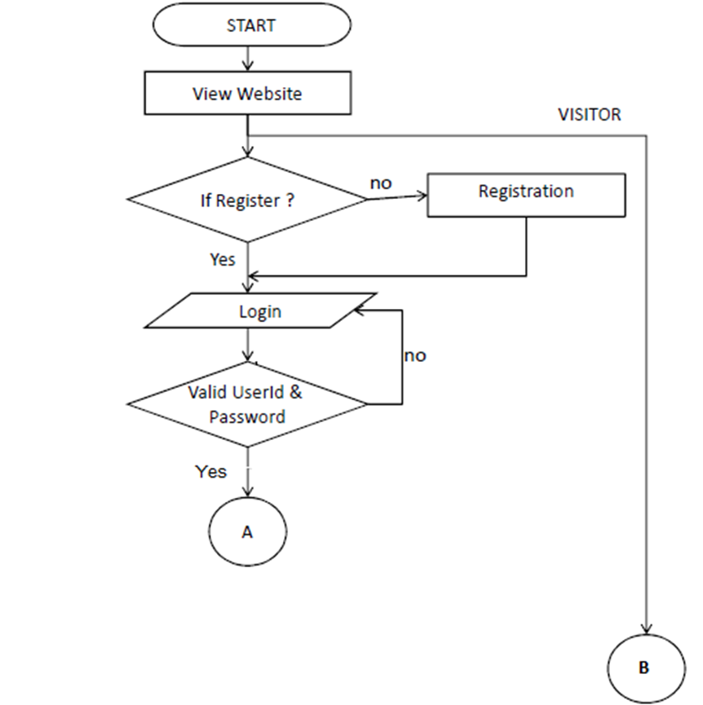
DATA FLOW DIAGRAM

Slide 6
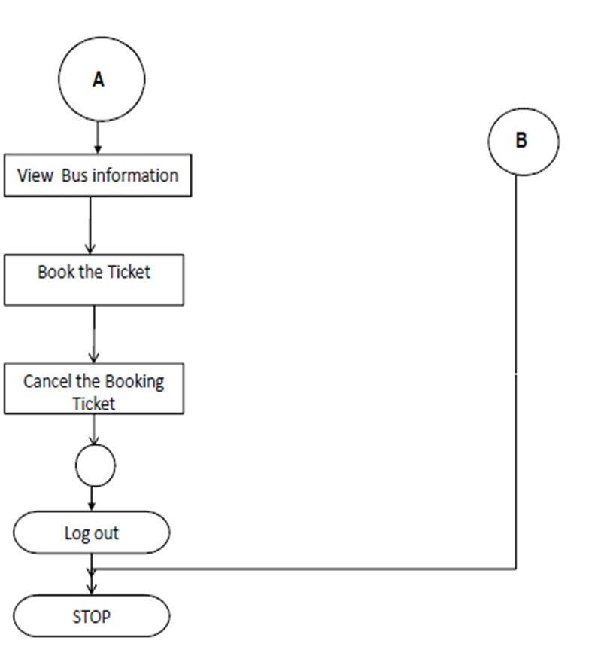

Slide 7
SCREENSHOT

Slide 8
MAIN

Slide 9
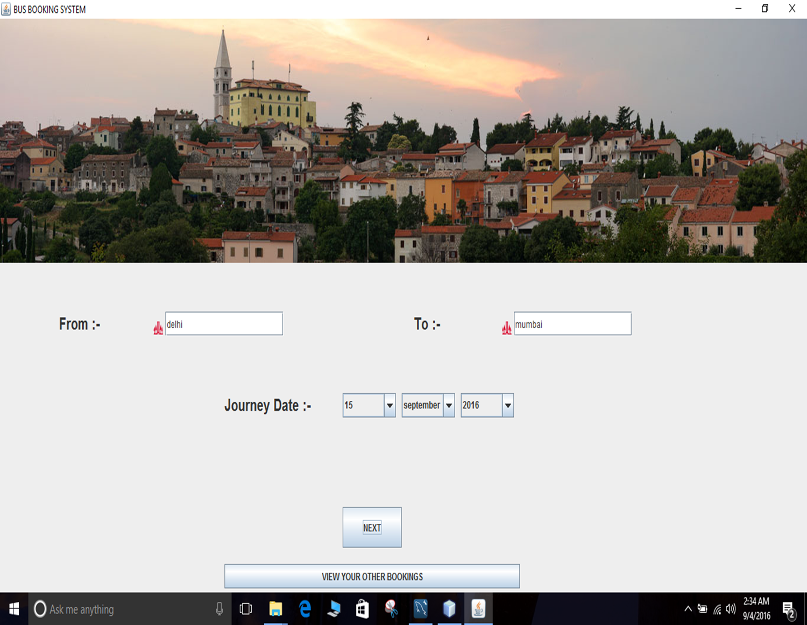

Slide 10
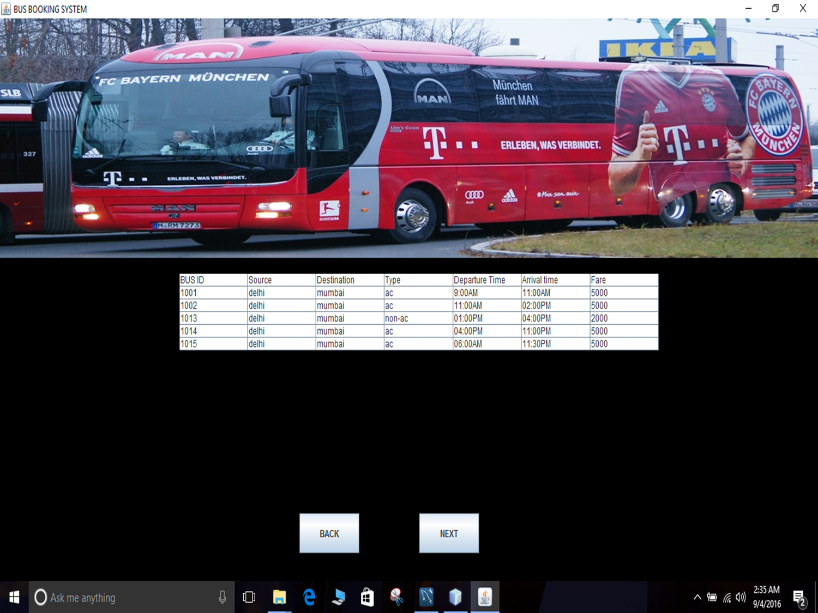

Slide 11
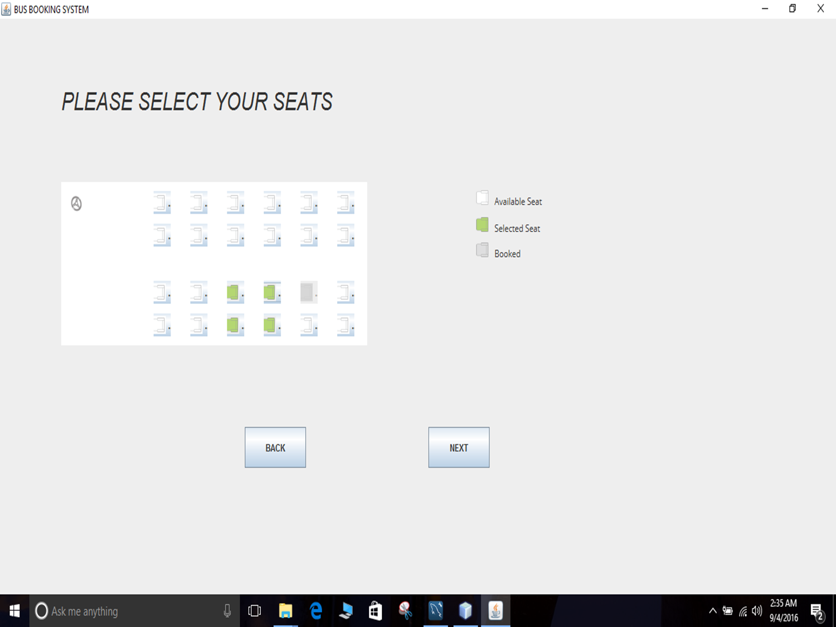

Slide 12
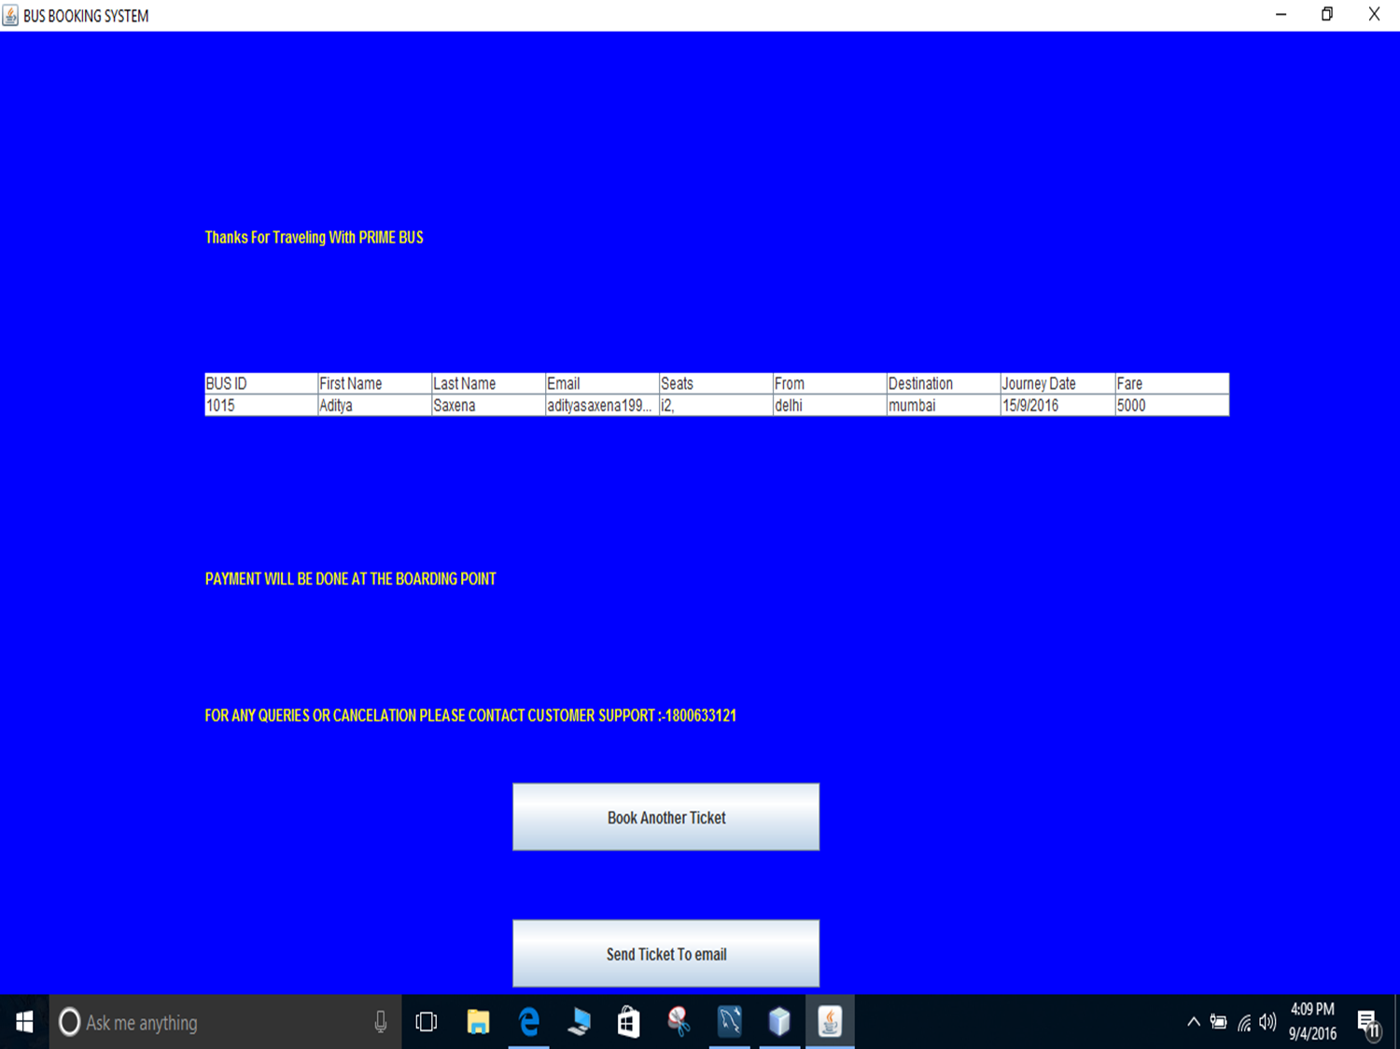

Slide 13
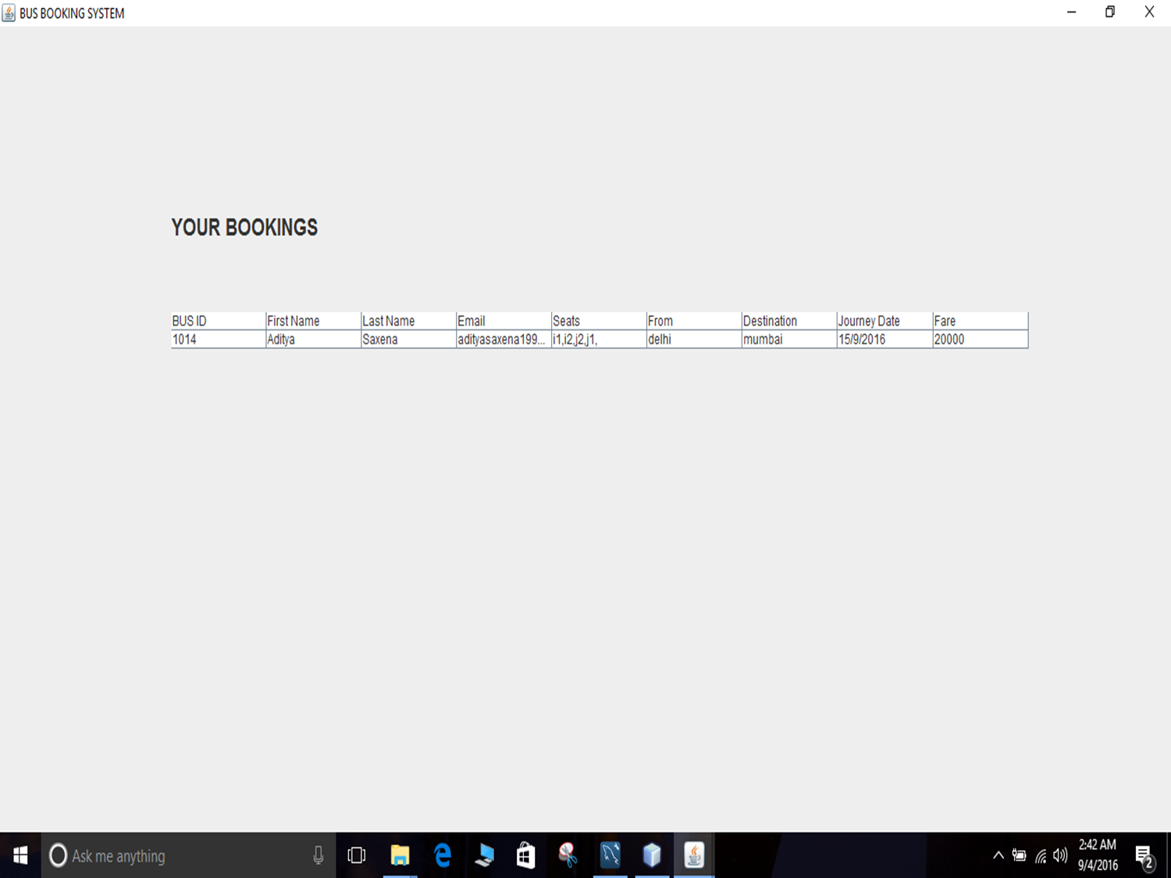

Slide 15
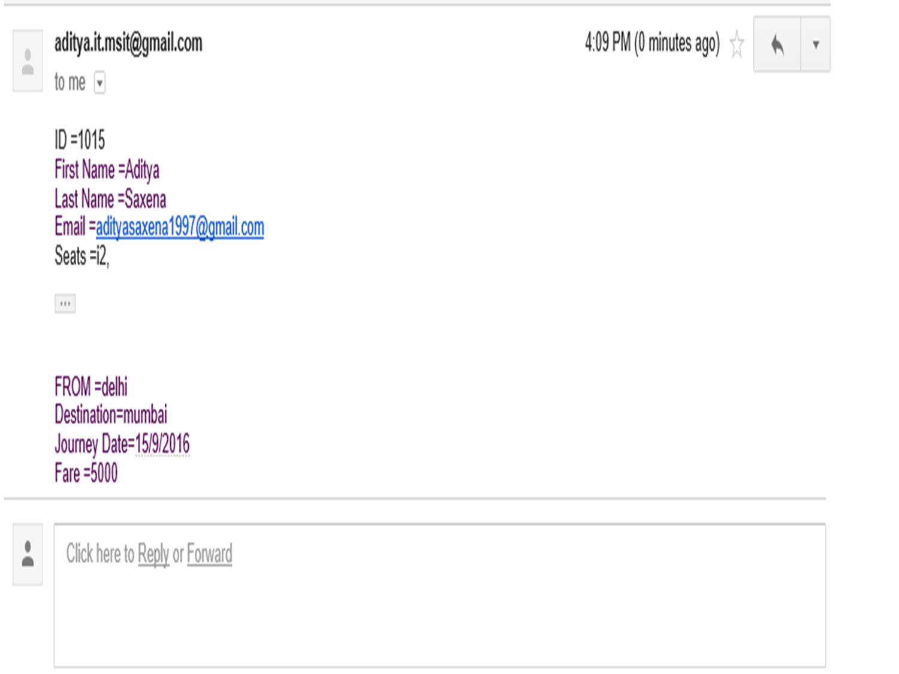

Slide 16
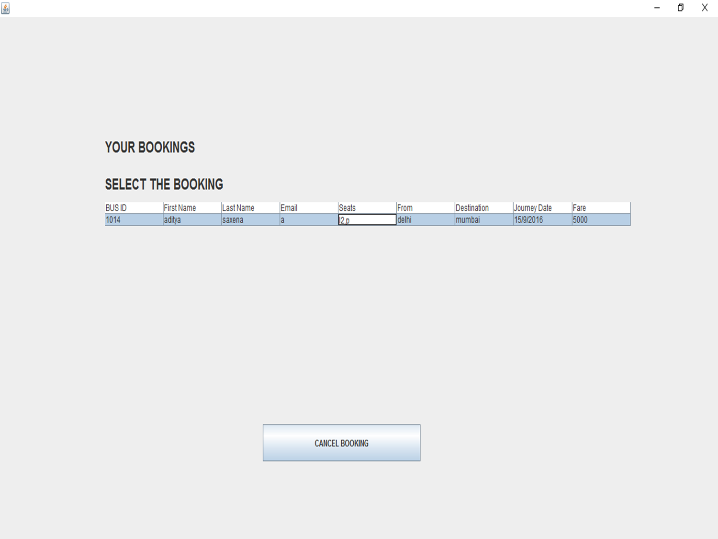

Slide 17
Future Enhancements
Creating an Android/IOS application .
Inclusion of METRO UI for desktop application
Linking our booking system with other centralized bus services
GPS tracking of the bus using special link provided to users.
Cloud database
Website
More data for visitors

Slide 18
Development
Basic java IDE.
Swing frame work for UI.
Various java plugins used.
MYSLQL for database management.

